Slide 1




Alpha Analysts
Jenny
Michelle
Scott
Thapa
Project Engineer
Strategy Consultant
Quality Assurance Manager
Project manager

Slide 2
Project Summary
Determine BUY-SELL signals for top performing US stocks using
MACD indicators and Time Series analysis
ML
Regression
Time
Series
ML
Classification
Buy-Sell
Signal

Slide 3
Project workflow
Date
Open
Low
High
Close
Adj Vol
Vol
2019-12-31
1842.0
1853.3
1832.22
1847.84
1847.39
2506500
2020-01-07
1904.5
1913.9
1892.04
1906.85
1906.85
4044900
2020-01-07
1904.5
1913.9
1892.04
1906.85
1906.85
4044900

Slide 4
Project workflow
ACF
PACF
Date
Close
2019-12-31
1847.84
2020-01-07
1906.85
2020-08-01
1906.85
AIC
BIC
2, 1, 1
4630.36
4650.57
1, 1, 2
4630.36
4650.57
1, 1, 3
4630.36
4650.57

Slide 5
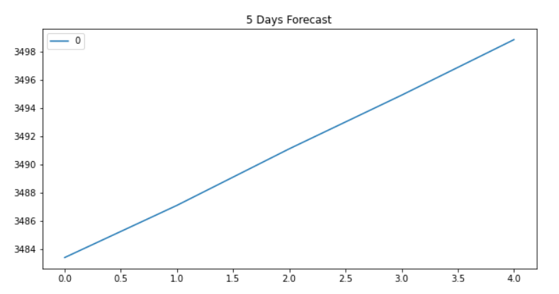
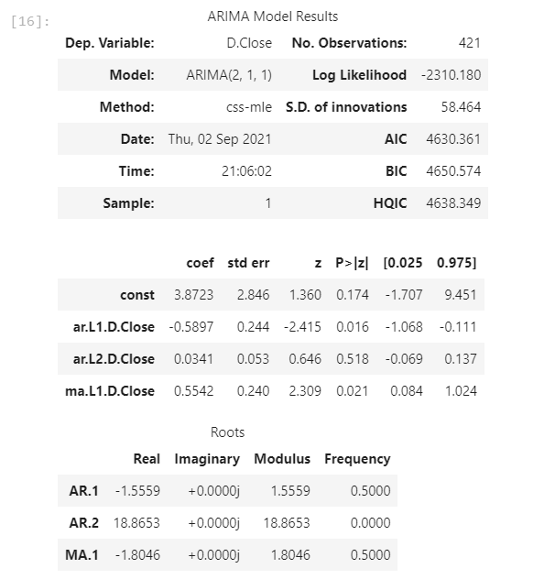
Times Series Analysis
Summary
Customer
Write your paragraph here
Write your paragraph here

Slide 6
Final data frame
Date
Close
2019-12-31
1847.84
Actual Close prices
2020-01-07
1906.85
2020-08-01
1906.85
Date
Close
Day 1
1847.84
Day 2
1906.85
Predicted Close prices
Write your paragraph here
Summary
Day 3
1906.85
Write your paragraph here
Day 4
1906.85
Day 5
1906.85

Slide 7
Machine Learning - Regression Models
 | Linear Regression | Random Forest | Extra Trees | Lasso Regression | Ridge Regression | Stochastic Gradient Design
Mean Squared Error | 0.245339 | 0.246907 | 0.247462 | 0.250000 | 0.245328 | 0.244234
Root Mean Squared Error | 0.495317 | 0.496897 | 0.497456 | 0.500000 | 0.495306 | 0.494201
R2 | -0.349802 | -0.358429 | -0.361484 | -0.375446 | -0.349742 | -0.343724
R square: Negative value
Models does not follow the
trend of the data
fits worse than a horizontal line

Slide 8
Machine Learning - Classifications
 | Logistic Regression | Random Forest | Gradient Boosting | Ada Boost | XGB
precision | 0.646031 | 0.646031 | 0.646031 | 0.646031 | 0.646031
recall | 0.647059 | 0.647059 | 0.647059 | 0.647059 | 0.647059
f1-score | 0.646315 | 0.646315 | 0.646315 | 0.646315 | 0.646315
support | 425.000000 | 425.000000 | 425.000000 | 425.000000 | 425.000000
mse | 0.352941 | 0.352941 | 0.352941 | 0.352941 | 0.352941
rmse | 0.594089 | 0.594089 | 0.594089 | 0.594089 | 0.594089
Not effective model to
match the stock current prices
Similar outcomes

Slide 9
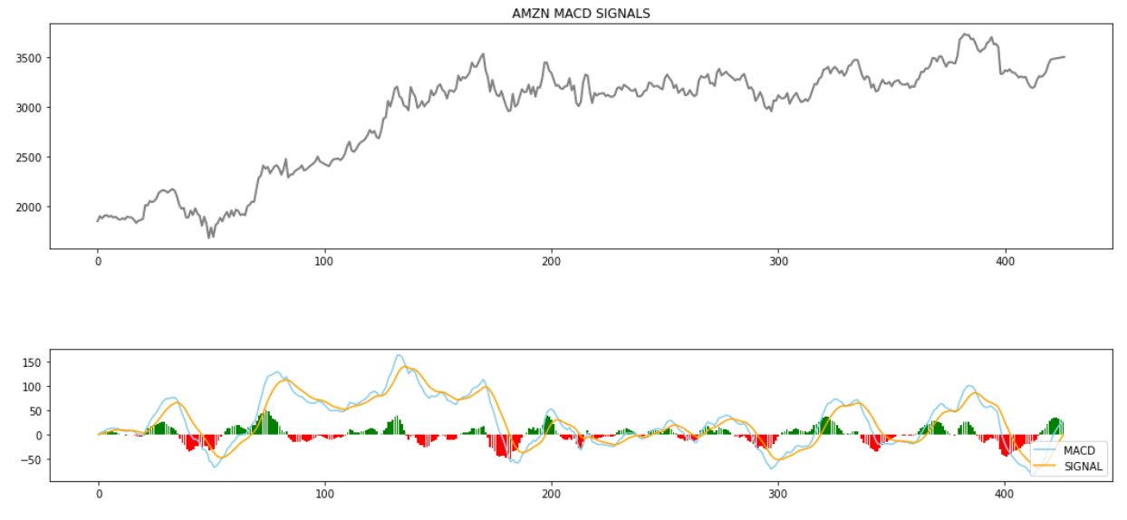
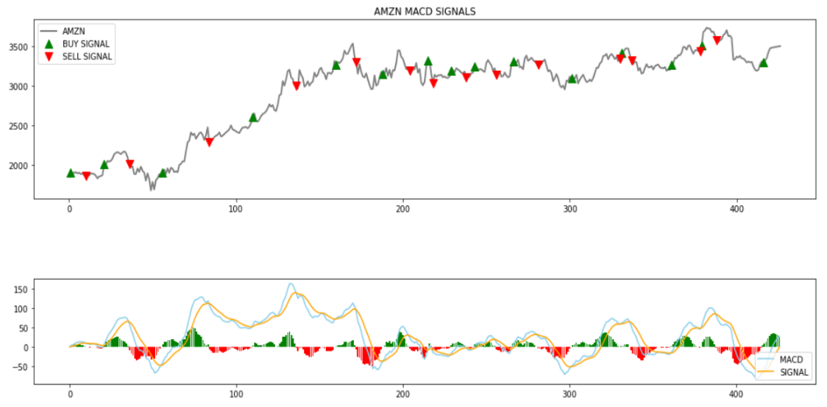
MACD Indicators
Summary
Customer
Write your paragraph here
Write your paragraph here

Slide 10
Model Performance Evaluations
Marketing is the study and management of exchange relationships. Marketing is the business process of creating relationships with and satisfying customers.
Step 03
Step 01
Write your paragraph here
Write your paragraph here
Step 02
Write your paragraph here

Slide 11
Conclusion
MACD prices are good indicators to generate BUY-SELL signals
However, other metrics such as Relative Strength Indicator (RSI) and Fibonacci indicators should also be used to make an informed decision to trigger a BUY or SELL

Slide 12
Any Questions…

Slide 13
Cloud Infographics
Marketing is the study and management of exchange relationships. Marketing is the business process of creating relationships with and satisfying customers.
Step 01
Step 03
Write your paragraph here
Write your paragraph here
Step 02
Step 04
Write your paragraph here
Write your paragraph here

Slide 14
Cloud Infographics
Marketing is the study and management of exchange relationships. Marketing is the business process of creating relationships with and satisfying customers.
Finance
Offer
Customer
Infrastructure
Write your paragraph here
Write your paragraph here
Write your paragraph here
Write your paragraph here

Slide 15
Cloud Infographics
Marketing is the study and management of exchange relationships. Marketing is the business process of creating relationships with and satisfying customers.
Write your paragraph here
Write your paragraph here
01
04
Write your paragraph here
Write your paragraph here
02
05
Write your paragraph here
Write your paragraph here
03
06

Slide 16
Cloud Infographics
Marketing is the study and management of exchange relationships. Marketing is the business process of creating relationships with and satisfying customers.
01
02
Signal
Call
Write your paragraph here
Write your paragraph here
Your Title

Slide 17
Cloud Infographics
Marketing is the study and management of exchange relationships. Marketing is the business process of creating relationships with and satisfying customers.
Infrastructure
Finance
Customer
Option 1
Option 2
Option 1
Option 2

Slide 18
Cloud Infographics
Marketing is the study and management of exchange relationships. Marketing is the business process of creating relationships with and satisfying customers.
Write your paragraph here
Write your paragraph here
Cycle
Write your paragraph here
Write your paragraph here

Slide 19
Cloud Infographics
Marketing is the study and management of exchange relationships. Marketing is the business process of creating relationships with and satisfying customers.
Finance
Offer
Write your paragraph here
Write your paragraph here
Your Title
Customer
Infrastructure
Write your paragraph here
Write your paragraph here

Slide 20
Cloud Infographics
Marketing is the study and management of exchange relationships. Marketing is the business process of creating relationships with and satisfying customers.
01
03
02
Step 01
Step 03
Write your paragraph here
Write your paragraph here
Step 02
Write your paragraph here

Slide 21
Cloud Infographics
Marketing is the study and management of exchange relationships. Marketing is the business process of creating relationships with and satisfying customers.
01
02
03
04
Finance
Customer
Offer
Infrastructure
Write your paragraph here
Write your paragraph here
Write your paragraph here
Write your paragraph here

Slide 22
Cloud Infographics
Marketing is the study and management of exchange relationships. Marketing is the business process of creating relationships with and satisfying customers.
01
Write your paragraph here
Finance
02
Write your paragraph here
03
Write your paragraph here

Slide 23
Cloud Infographics
Marketing is the study and management of exchange relationships. Marketing is the business process of creating relationships with and satisfying customers.
Step 01
Step 02
Step 03
Write your paragraph here
Write your paragraph here
Write your paragraph here

Slide 24
Cloud Infographics
Marketing is the study and management of exchange relationships. Marketing is the business process of creating relationships with and satisfying customers.
• Write your paragraph here
Step 01
• Write your paragraph here
• Write your paragraph here
• Write your paragraph here
Step 02
• Write your paragraph here
• Write your paragraph here

Slide 25
Cloud Infographics
Marketing is the study and management of exchange relationships. Marketing is the business process of creating relationships with and satisfying customers.
Step 04
Write your paragraph here
Step 01
Write your paragraph here
Step 03
Write your paragraph here
Step 02
Write your paragraph here

